Slide 1
2017 VJISS SUMMIT:
MAKING VJISS WORK FOR YOU
February 7, 2017
Vermont Department of Public Safety

Slide 2
WHY
ARE YOU HERE?

Slide 3
We want to improve VJISS
and we need your help!

Slide 4
The Vermont justice system begins with law enforcement.

Slide 5
VERMONT JUSTICE SYSTEM
Law Enforcement
Pretrial Services
Probation
& Parole
Prosecution
Court
Corrections

Slide 6
SURVEY RESULTS

Slide 7
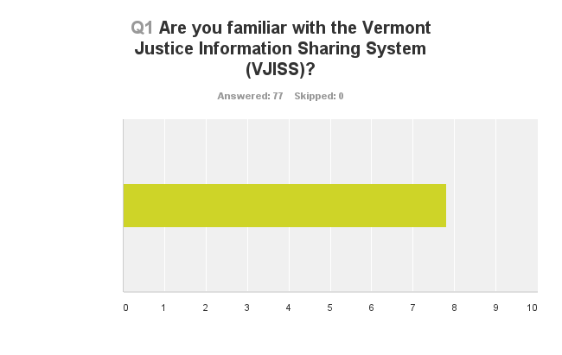

Slide 8
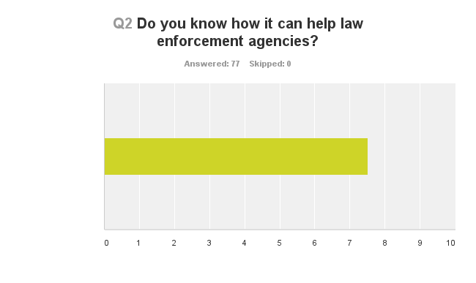

Slide 9
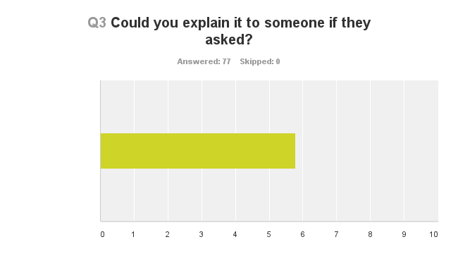

Slide 10
WHAT
IS VJISS?

Slide 11
A statewide portal used to share justice information between and among authorized users and systems.

Slide 12
AUTHORIZED USERS
EXCHANGE
ALERT
ANALYZE
SEARCH

Slide 13
STATEWIDE PORTAL
LAW
ENFORCEMENT
PROBATION
&
PAROLE
PRETRIAL
SERVICES
CORRECTIONS
PROSECUTION
COURTS

Slide 14
Designed to promote data-driven justice decisions, as well as enhance the effectiveness of justice policies and practices throughout the state.

Slide 15
JUSTICE DECISIONS
STRATEGIC
TACTICAL
OPERATIONAL

Slide 16
It provides a suite of data and information sharing tools to support more effective strategic, tactical, and operational decisions.

Slide 17
SUITE OF TOOLS
SEARCH
ALERT
ANALYZE
MAP
EXCHANGE
VJISS
VJISS
VJISS
VJISS
VJISS

Slide 18
WHO
CAN VISS HELP?

Slide 19
LAW ENFORCEMENT
PROBATION
& PAROLE
PRETRIAL
SERVICES
JUSTICE SYSTEM
CORRECTIONS
PROSECUTION
COURTS

Slide 20
EXECUTIVES
FIELD STAFF
LAW ENFORCEMENT
INVESTIGATORS
ANALYSTS

Slide 21
HOW
CAN VJISS HELP?

Slide 22
INFORMATION SHARING AND
DATA ANALYSIS

Slide 23
SURVEY RESULTS

Slide 24
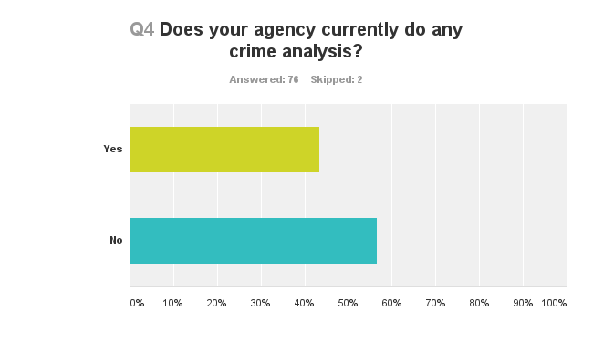

Slide 25
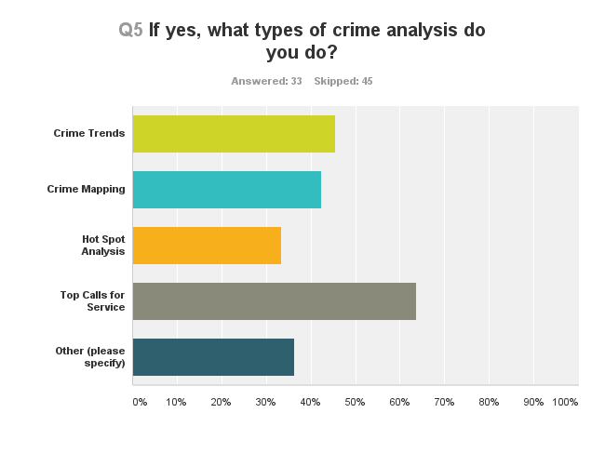

Slide 26
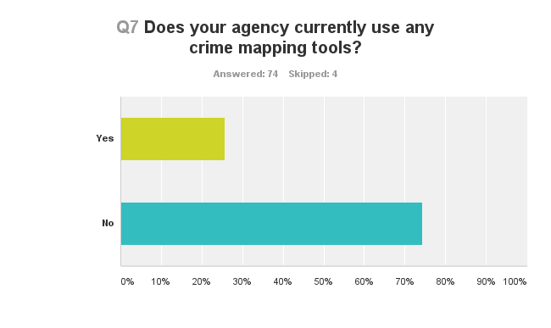

Slide 27
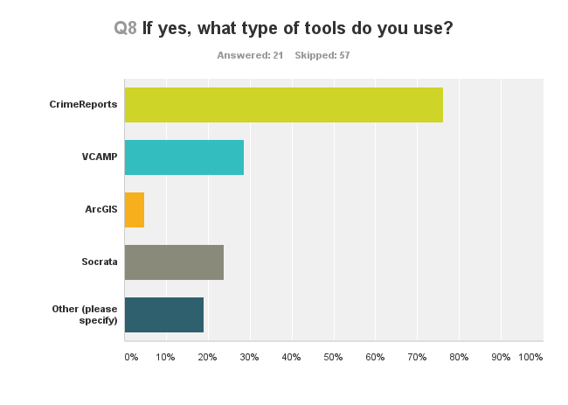

Slide 28
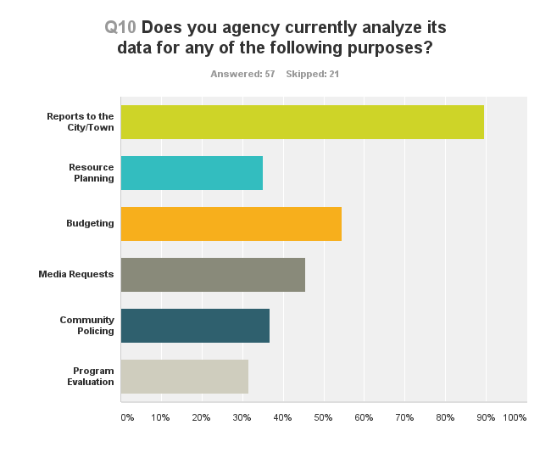

Slide 29
YOU HAVE QUESTIONS!
What is the top call for service?
When do most crimes occur?
Where do most crimes occur?
Has John Smith been rearrested?

Slide 30
VJISS HAS ANSWERS!
Traffic offenses
Monday between 0900-1700
Main Street & 1st Avenue
Yes, yesterday for a traffic offense

Slide 31
You just have to pick
the right tool for the job!

Slide 32
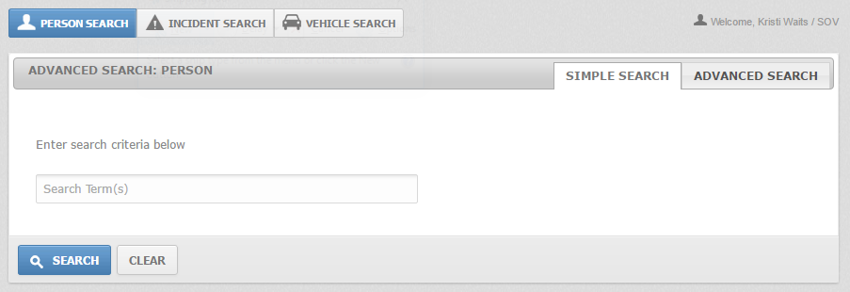
SEARCH

Slide 33
Can help…
Investigators tracks offenders.
Admin staff assist patrons.
Officers track vehicles.

Slide 34
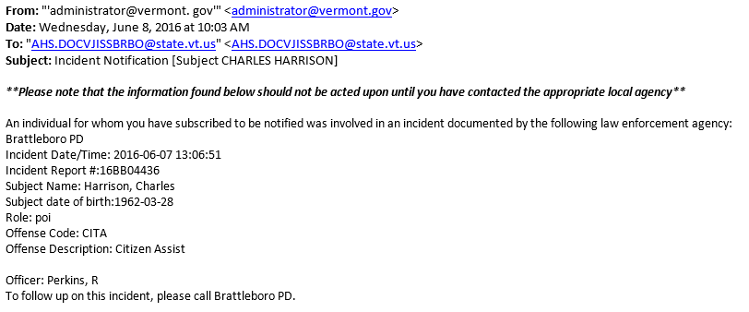
ALERT

Slide 35
Can help…
Investigators with a case.
Undercover operations track officers.
Child protective services track parents.
Parole/prob agents track offenders.

Slide 36
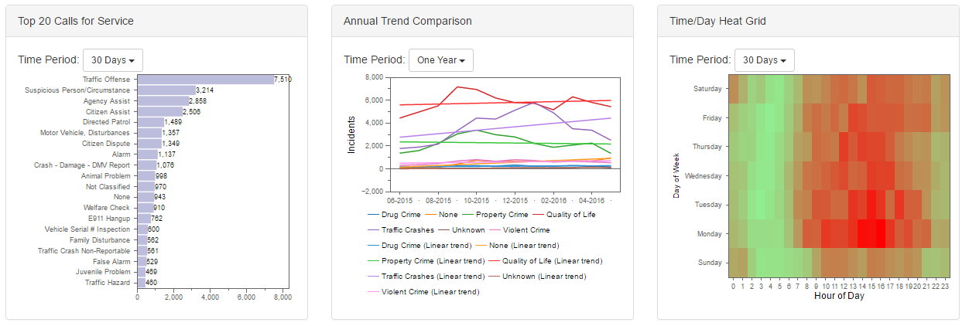
ANALYZE

Slide 37
Can help…
Executives track calls for service.
Analysts track crime rates.
Patrol commanders target resources.
Researchers track recidivism rates.

Slide 38
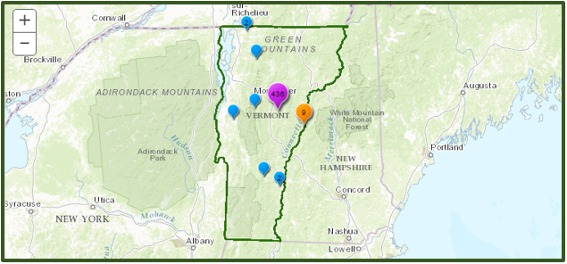
MAP

Slide 39
Can help…
Executives map crimes by types.
Executives identify hot spots.
Analysts identify crime trends by location.

Slide 40
EXCHANGE
01234567890123456789123456789123456789
Police
Courts

Slide 41
Can help…
Law enforcement push data to courts.
Courts push data to law enforcement.
Pretrial services pull data from law enforcement.

Slide 42
EXERCISE #1

Slide 43
VJISS
SEARCH

Slide 44
EXERCISE #2

Slide 45
VJISS
ALERT

Slide 46
EXERCISE #3

Slide 47
VJISS
ANALYZE

Slide 48
EXERCISE #4

Slide 49
VJISS
MAP

Slide 50
NEXT STEPS

Slide 51
Follow-Up Survey
Prioritize Projects
VJISS Workgroup
VJISS Newsletter

Slide 52
HOW CAN WE SPREAD THE WORD?

Slide 53
www.dps.vermont.gov/vjiss

Slide 54
Contact Info…
Kristi Waits
Department of Public Safety
Project Manager
kristi.waits@vermont.gov
802-241-5397

